Slide 1
SMB Partner Opportunity
August 2019

Slide 2
Partner Opportunity
Azure SMB Partner Opportunity
Why Migrate to Azure
Next steps

Slide 3
Cloud migration services account for up to 30%
of the overall implementation service market, representing $72.4 billion¹ in market revenue opportunities worldwide.
$72.4B
¹in constant dollars
Source: Market Insight: Cloud Migration Part 1—Where Are the Opportunities for Service Providers?
By Gartner Research, published 17 May 2018
Notes:
There is great opportunity for partners looking to migrate their customers to the cloud.
Cloud migration services account for up to 30% of the overall implementation service market, representing $72.4 billion¹ in market revenue opportunities worldwide.
¹in constant dollars. Source: Market Insight: Cloud Migration Part 1—Where Are the Opportunities for Service Providers? By Gartner Research, published 17 May 2018

Slide 4
SMB migration partner opportunity
50%
70%
Of large SMBs are moving to the cloud in the next 12 months
The small and midsize markets account for ~70% of the worldwide cloud migration service market spending
Source: Microsoft Internal Research on US Quantitative survey of SMB ITDMs and BDMs currently using or considering cloud services (org size 75-249 employees)
Source: Gartner, Market Insight: Cloud Migration Part 1 — Where Are the Opportunities for Service Providers? Figure 4., May 2018
Notes:
There is a partner opportunity to migrate SMB customers to Azure
50% of SMB customers are moving to cloud in the next 12 months (MS SMB Cloud Journey research based on 375 US SMB survey)
In addition, Small and midsize markets account for ~70% of the worldwide cloud migration service market spending
There is a clear momentum and an opportunity for partners to engage SMBs

Slide 5
Azure partner
opportunity
30-33% attach
Managed services
$$
45–54% margins
90% attach
Migration execution
$$
25–40% margins
55% attach
Strategy and assessments
$
25–30% margins
Modernization
$$
42–46% margins
20% attach
Cloud application development
$$$
45–50% margins
10% attach
Value-added IP
$$
80% margins
Note: all margins used in the chart above represent gross margins
Source: “The Partner Opportunity Assessment for Azure Service Providers," a commissioned Total Economic Impact™ study conducted by Forrester Consulting., July 2019
Notes:
Part of the Azure partner opportunity is attaching higher revenue services
You can see here that migration is the gateway to these higher revenue services
The opportunity doesn’t end at first sale but continues as migration needs change and grow for your customers

Slide 6
FY20 Azure sales
and partner priorities
Migrate existing
apps to Azure
and optimize
Innovate with
new apps and
modernize
existing apps
MIGRATE
INNOVATE
Applications, Infrastructure, Data, AI
ENABLE
Enable customers for successful cloud use
Notes:
Azure is prioritized around the following in FY20:
Migrate existing apps to Azure and optimize
Enable customers for successful cloud use
Innovate with new apps and modernize existing apps

Slide 7
Migrate scenarios
Meet the growing digital transformation needs of our customers
Migrate existing apps
to Azure and optimize
Modernize existing apps
and build new apps
Windows Server
SQL Server based apps
Linux & OSS DB
Web Apps
Personalized recommendations
Real-time streaming analytics
Predictive Maintenance,
Risk-Fraud prevention
AR/VR/IoT
MIGRATE
INNOVATE
ENABLE
Enable customers for successful cloud use
Cloud Adoption Framework, skills building,
cloud governance
Cloud adoption framework, skills building,
cloud governance
Notes:
Our partners are focusing on migration to meet the growing digital transformation needs of our customers
Migrate existing apps to Azure and optimize
Windows Server
SQL Server based apps
Linux & OSS DB
Web Apps

Slide 8
Partner Opportunity
Azure SMB Partner Opportunity
Why Migrate to Azure
Next steps

Slide 9
Why customers migrate to Azure
Unparalleled Innovation
Azure SQL Database
Azure IaaS
Azure Migrate/ Azure Lighthouse
Unmatched Security
Azure Security Center
Azure Sentinel
Confidential Computing
Unbeatable Offers/Programs
Free Extended Security Updates
Azure Migration Program
ISV Certification Hub
Hybrid by design
SQL code parity | Windows Admin Center | Azure Hybrid Benefit
Notes:
Why customers migrate to Azure: Azure Migrate now delivers a unified, integrated experience across Azure and ISV tools, so you can pick the tool that best meets your needs.
Partners deliver value from migrating their customers to Azure:
Unparalleled Innovation: Azure SQL Database, Azure IaaS, and Azure Migration / Azure Lighthouse
Unmatched Security: Azure Security Center, Azure Sentinel, and Confidential Computing
Unbeatable Offers/Programs: Free Extended Security Updates, Azure Migration Program, and ISV Certification Hub
Azure is hybrid by design with SQL code parity, Windows Admin Center, and Azure Hybrid Benefit

Slide 10
Windows Server migration
OPPORTUNITY
SOLUTION
Windows Server + Azure better together
  Comprehensive hybrid protection: Azure Security Center
  Modern management: Windows Admin Center
  Integrated identity, backup, disaster recovery
>70%
  of world’s on-premises servers run Windows Server
GO-DOS
Migrate
  Windows Server to Azure VMs
Attach
  Azure security/ management
  to migrated VMs
  Help customers save money
  with Server Subscriptions & Extended Security Updates
* *Source VMware, 2018
Notes:
Opportunity: 70% of the world’s on-premises servers run Windows Server
Solution: Windows Server is better with Azure
Comprehensive hybrid protection: Azure Security Center
Modern management: Windows Admin Center
Integrated identity, backup, disaster recovery
Go-Dos: Enable your customers
Migrate Windows Server to Azure VMs
Attach Azure security/ management to migrated VMs
Leverage Azure Hybrid Benefit, Server Subscriptions & Reserved Instances to get the best solution in place for your customer

Slide 11
SQL Server migration
OPPORTUNITY
SOLUTION
1 in 3 on-premises databases is a SQL Server¹
98 of Fortune 100 run SQL Server
Azure SQL Database Managed Instance
  Migrate SQL apps without changing code
  Code parity | Evergreen | Built-in HA
GO-DOS
Migrate
  SQL Server to Azure SQL Database Managed Instance
Migrate
  SQL Server to Azure VMs based on customer scenario
  Help customers save money
  with Server Subscriptions & Extended Security Updates
1: https://db-engines.com/en/system/Microsoft+SQL+Server
Notes:
Opportunity:
1 in 3 on-premises databases is a SQL Server
98 of Fortune 100 run SQL Server
Solution: SQL Server is better with Azure
Azure SQL Database Managed Instance
Migrate SQL apps without changing code
Code parity | Evergreen | Built-in HA
Go-Dos:
Migrate SQL Server to Azure SQL Database Managed Instance
Migrate SQL Server to Azure VMs based on customer scenario
Leverage Azure Hybrid Benefit, Server Subscriptions & Reserved Instances to get the best solution in place for your customer

Slide 12
Linux/OSS DB migration
OPPORTUNITY
SOLUTION
  50% of Azure compute is Linux
  70% of Red Hat, SUSE, Cloudera, Pivotal, Elastic deployments run on-premises
  80% of Web Apps run MySQL
  Azure IaaS for Linux VMs
  Azure Marketplace solutions from top Linux ISVs
  Azure Database for MySQL/ PostgreSQL/ Maria DB
  Azure Cosmos DB for MongoDB, Cassandra, Hbase
GO-DOS
Identify
  Microsoft-friendly customers who run Linux & Open Source Databases
Migrate
  open source SQL and NoSQL databases to fully managed Azure services
Co-sell
  Azure migration with Red Hat, SUSE, Cloudera, Pivotal, Elastic
* *Source VMware, 2018
Notes:
Opportunity:
50% of Azure compute is Linux
70% of Red Hat, SUSE, Cloudera, Pivotal, Elastic deployments run on-premises
80% of Web Apps run MySQL
Solution: Linux/OSS DB is better with Azure
Azure Marketplace solutions from top Linux ISVs
Azure Database for MySQL/ PostgreSQL/ Maria DB
Azure Cosmos DB for MongoDB, Cassandra, Hbase
Go-Dos:
Identify Microsoft-friendly customers who run Linux & Open Source Databases
Migrate open source SQL and NoSQL databases to fully managed Azure services
Co-sell Azure migration with Red Hat, SUSE, Cloudera, Pivotal, Elastic

Slide 13
Web apps migration
OPPORTUNITY
SOLUTION
Build, deploy, and scale web apps
on a fully managed platform
Support for most common languages/frameworks
Built-in DevOps and monitoring
Automated assessment and migration
30M ASP.NET public websites
Just 1M+ already in Azure
GO-DOS
Pitch
  the benefits of App Service and other fully managed services for web applications workloads
Assess
  any website and migrate ASP.NET or PHP apps using the App Service Migration Assistant
Help
  customers optimize and modernize web apps faster to differentiate through innovation
* Source BuiltWith and Microsoft Internal data
Notes:
Opportunity:
30 million ASP.NET public websites
Just 1 million already in Azure
Solution: Web apps are better with Azure
Support for most common languages/frameworks
Built-in DevOps and monitoring
Automated assessment and migration
Go-Dos:
Pitch the benefits of App Service and other fully managed services for web applications workloads
Assess any website and migrate ASP.NET or PHP apps using the App Service Migration Assistant
Help customers optimize and modernize web apps faster to differentiate through innovation

Slide 14
Grow your business in CSP with Microsoft’s Marketplace
  Develop new partner relationships or leverage IP assets in the marketplace from existing partnerships to deliver managed services on top of industry leading software that runs on Azure
  Better serve end customers and grow your services business by bundling Azure with ISV solutions
  Shorten procurement time and reduce operational friction of BYOL; deploy and manage ISV solutions optimized for Azure environments
Azure Marketplace and AppSource
  Expand revenue opportunities by accessing Microsoft’s catalog of over 10,000 3rd partner offers through Partner Center and within customer tenants
  Simplified billing for 1st and 3rd party offerings, standard legal agreements, and billing and account support for partners
  Sell your products and services through marketplace to reach new customers and monetize your investments in IP
  Accelerate customer growth: sell more Azure, Office 365 and Dynamics 365 by bundling complementary software and add-ins that increase customer usage
Notes:
Marketplace:
Marketplace is a consolidated catalog SaaS, IaaS products built on Azure as well as add-ins for Office and D365, software and consulting services available to customers through in product experiences (Azure Portal) and web storefronts: Azure Marketplace and App Source.
Includes paid offers as well as Free and BYOL (Bring Your Own License)
Recently release feature (March) that allow ISV partners to make their products available for sale through the CSP program.
Roadmap: Seat based SaaS billing model (May) custom metered solutions (July), improved UX for ISVs to onboard and engage with CSP.
Incentives:
New incentive program for IP Co-sell qualified paid SaaS offers for 10% of the retail price paid as an incentive to the transacting partner.
Offers:
As of 5/1/19 Marketplace has about 250 transactable 3rd party solutions in CSP and growing, and over 5000 free and bring your own license offers available to CSP partners through partner center UX and APIs.
Paid marketplace offers are included in the Azure Price list for CSP partners
Support:
CSP partners will manage the billing relationship with customer for marketplace offers and technical support will be the responsibility of the ISV partner.

Slide 15




Partner with Microsoft Azure to migrate your customers
‟
Migration is very critical for us, and that's why we've had to do this in different ways, because different organizations have different phases of maturity and industry.”
- Wragby, Dr. Oluyomi Alarape
  Helped financial services firms run their business with cloud marketplace built on Azure
  Leveraged Azure platform to enable SMBs to increase customer engagement
Notes:
Partners like Wragby have helped their customers migrate with great results
There are about twenty seven to twenty nine million, a small medium enterprise in Nigeria. And they currently employ about 80% of the working population.
Wragby was first company working with Azure Container systems in Nigeria
According to Wragby, “Migration is very critical for us, and that's why we've had to do this in different ways, because different organizations have different phases of maturity and industry.” - Wragby, Dr. Oluyomi Alarape
Wragby did the following:
Helped financial services firms run their business with cloud marketplace built on Azure
Leveraged Azure platform to enable customers to increase customer engagement
Microsoft recognized Wragby as Microsoft Country Partner of the Year for Nigeria

Slide 16
Partner Opportunity
Azure SMB Partner Opportunity
Why Migrate to Azure
Next steps

Slide 17

Win with Microsoft Azure
011010
1010
001101010
011001
Learn more at http://azure.com/partners
Build cloud practices and IP on Microsoft Azure
Capitalize on growing SMB cloud Migration momentum
Explore the Windows Server and SQL Migration and Web App Modernization opportunity
Build your Azure migration practice with the latest practice guidance
Differentiate your practice by earning Azure advanced specialization
Unlock the benefits of being an Indirect Reseller of Azure with CSP
Get all the tools and resources you need to migrate apps, data, and infrastructure with confidence
Leverage great marketing content to support you with Digital Marketing Content OnDemand
Sign up to the Cloud Enablement Desk to accelerate your business growth
Deliver differentiated managed services with Azure Lighthouse
Access the Azure Migration Program for Partners
Get the resources to accelerate your business
Notes:
Win with Microsoft by:
Building cloud practices and IP on Microsoft Azure
Capitalizing on growing SMB cloud Migration momentum
Build cloud practices and IP on Microsoft Azure
Explore the Windows Server and SQL Migration and Web App Modernization opportunity
Build your Azure migration practice with the latest practice guidance
Differentiate your practice by earning Azure advanced specialization
Unlock the benefits of being an Indirect Reseller of Azure with CSP
Capitalize on growing SMB cloud Migration momentum
Get the resources to accelerate your business.
Get all the tools and resources you need to migrate apps, data, and infrastructure with confidence.
Leverage great marketing content to support you with Digital Marketing Content OnDemand
Sign up to the Cloud Enablement Desk to accelerate your business growth
Deliver differentiated managed services with Azure Lighthouse
Access the Azure Migration Program for Partners

Slide 18

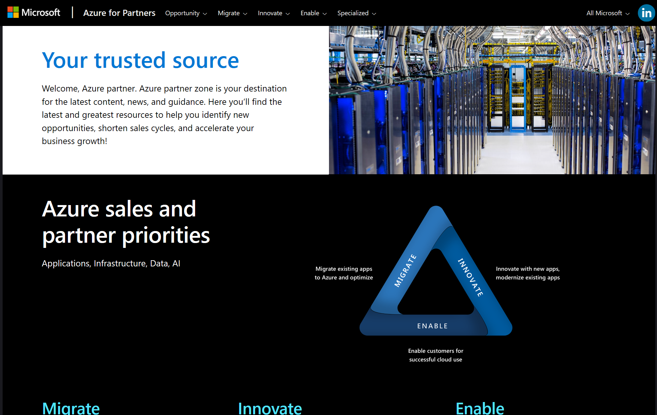
New
Azure partner zone
Your destination for the latest content, news and guidance
http://azure.com/partners
Notes:
Azure Partner Zone: Your destination for the latest content, news and guidance
http://azure.com/partners

Slide 19
Thank you

Slide 20
Appendix

Slide 21
Unlocking best pricing for SMB customers
Variable Workloads
Application development, testing
e-Commerce
Analytics & Data Science
Reporting
Predictable Workloads
Line of Business Apps
CRM
Content Management
Procurement, Asset Management
Customers desire efficiency,
performance, scalability
Customers desire cost savings,
prioritized capacity, flexibility
Azure Hybrid Benefit | Pay-As-You-Go
For customers with Software Assurance
Azure Hybrid Benefit | Reserved Instances
For customers with Software Assurance
Pay-As-You-Go
For customers without Software Assurance
Server Subscription | Reserved Instances
For customers without Software Assurance

Slide 22
Announcing Azure Migration Program (AMP)
Available to all Azure customers, scaled through specialized migration partners
Best practice guidance, CAF
Infrastructure and
data foundations
Offers, funding, credits
Migration planning
and execution
Technical skill building
Specialized partners
Learn more and nominate your customers: Azure.com/AMP

Slide 23

Azure Migration Program (AMP) for Partners
Participating specialized migration partners
Access agile funds
and resources
Receive qualified
leads
Attach high-value
services
Learn more at Azure.com/amppartners
Notes:
Interested in participating in becoming a specialized migration partner? Join the Azure Expert MSP program
or obtain the Windows Server/ SQL Server advanced specialization to get started.
Accelerate Migration Opp
Access expert guidance and resources from Azure Engineering and agile funds to accelerate your customers migration needs and unlock new opportunities to land new managed services
Receive Qualified Leads
Qualify for frictionless and proactive engagement with field sellers
Benefit from promotion through demand generation
Attach Higher Value Services
Obtain new estate management incentives via PAL when providing management services
Create new opportunities for modernization and innovation unblocked by migration

